Slide 1


Haydee M. Dominguez
October 10th, 2023

Slide 2

Outline
Executive Summary
Introduction
Methodology
Results
Conclusion
Appendix

Slide 3
Executive Summary
Summary of methodologies
Summary of all results

Slide 4
Introduction
Our company SpaceY aims to provide affordable space travel
Most providers are currently offering launches that cost over USD$165 million
SpaceX is currently advertising Falcon 9 rocket launches at a cost of USD$62 million
By reusing the first stage of Falcon 9 rockets, SpaceX can significantly reduce costs
For our enterprise to be successful, we must be able to offer competitive prices
As a first step, our goals are:
To gather information about SpaceX launches
To explore the relationship between predictor variables and landing outcome
To determine if SpaceX will reuse the first stage of their launches
To determine the price of SpaceX launches

Slide 5

Section 1

Slide 6
Methodology
Executive Summary
Data collection methodology:
We used the SpaceX REST API and web scraped a Wiki page for past SpaceX launch data
Perform data wrangling
We inspected the data and created a target variable Y by converting the Outcome attribute into successful (1) and unsuccessful (0) landings
Perform exploratory data analysis (EDA) using visualization and SQL
Perform interactive visual analytics using Folium and Plotly Dash
Perform predictive analysis using four classification models
For each model we split the data into training and testing sets, we built and obtained the best model parameters based on the train set, and evaluated the model using the test set

Slide 7
Data Collection
Python code was used for data collection
Two main sources of information were used to collect data:
1) Get requests were made to several endpoints of the SpaceX REST API to collect data on launches including information about:
The rocket used, payload delivered, launch specifications, landing specifications, and landing outcome
2) Web scraping was used on a selected Wiki page: https://en.wikipedia.org/wiki/List_of_Falcon_9_and_Falcon_Heavy_launches
Falcon 9 launch records were extracted from an HTML table using the BeautifulSoup package
The rows of the relevant HTML table were scraped to save launch records into a python dictionary that was converted to a dataframe

Slide 8
Data Collection – SpaceX API
Get requests were performed on different endpoints of the SpaceX REST API to collect information on past launches and save them into a pandas dataframe
GitHub URL for the SpaceX API calls notebook: https://github.com/mtejo/ibmcapstone/blob/main/jupyter-labs-spacex-data-collection-api-HMDTCompleted.ipynb
Get request to SpaceX REST API
Normalize the response json object
Save response as a pandas dataframe
Subset the dataframe for selected features & a selected time frame & Falcon 9 launches
Replace missing values of features
Use dataframe columns to make other API calls to append additional information to the final dataframe

Slide 9
Create a BeautifulSoup object from the HTML response
Data Collection - Scraping
A get request was performed on a selected Wiki page to extract launch records from an HTML table into a python dictionary and convert it to a dataframe
GitHub URL for the web scraping notebook: https://github.com/mtejo/ibmcapstone/blob/main/jupyter-labs-webscraping-HMDTCompleted.ipynb
Get request to Falcon9 Launch HTML page
Create BeautifulSoup object from the HTML response
Extract column names from table of interest
Create a dictionary with column name keys
Fill dictionary with launch records extracted from table rows
Create a dataframe from the dictionary

Slide 10
Data Wrangling
Basic EDA was used to explore launches per site, per orbit, and launch outcome per orbit type
The outcome feature was further processed to create our target variable ‘Class’, which classified successful and failed launches
GitHub URL for the data wrangling notebooks: https://github.com/mtejo/ibmcapstone/blob/main/SkillsNetwork_labs_module_1_L3_labs-jupyter-spacex-data_wrangling_jupyterlite-HMDTComplete.jupyterlite.ipynb
Calculate number of launches per launch site
Calculate number of launches per orbit type
Calculate mission outcome per orbit type
Explore the different landing outcomes
Create a landing class variable to separate successful (1) vs unsuccessful (0) landings
Append the variable as the target feature ‘Class’ to the launch dataframe

Slide 11
EDA with Data Visualization
Three types of charts were used to explore the data:
Scatter plots to observe relationships between these variables and the color-coded landing outcome: Flight Number vs. Launch Site, Payload vs. Launch Site, Flight number vs. Orbit type, and Payload vs. Orbit type.
A bar chart to visually inspect the relationship between success rate and orbit type
A line chart to observe trends in average launch success rate per year
Feature engineering was achieved by one-hot encoding (creating dummies) of the categorical columns followed by their conversion to float type
GitHub URL for EDA with data visualization notebook: https://github.com/mtejo/ibmcapstone/blob/main/SkillsNetwork_labs_module_2_jupyter-labs-eda-dataviz.ipynb-HMDTComplete.jupyterlite.ipynb

Slide 12
EDA with SQL
SQL queries were performed to:
Obtain the names of the unique launch sites
Display 5 records where the launch site began with the string ‘CCA’
Display the total payload mass carried by boosters launched by NASA (CRS)
Display the average payload mass carried by booster version F9 v1.1
List the date when the first successful landing outcome in ground pad was achieved
List the names of the boosters which had success in drone ship and had payload mass greater than 4000 but less than 6000
List the total number of successful and failed mission outcomes
List the names of the booster versions which have carried the maximum payload mass
List records with month, failure landing outcomes in drone ship, booster versions and launch_site for the months of 2015
Rank the count of landing between the date 2010-06-04 and 2017-03-20, in descending order
GitHub URL for EDA with SQL notebook: https://github.com/mtejo/ibmcapstone/blob/main/jupyter-labs-eda-sql-coursera_sqllite-HMDTComplete.ipynb

Slide 13
Build an Interactive Map with Folium
Using Folium, a map was created centered around the NASA Johnson Space Center in Houston, Texas, and a circle object was created around the Space Center
Circle objects with pop up labels were added to the map to locate the different launch sites based on their latitude and longitude coordinates
Markers were created with a MarkerCluster object to show the result (success or failure) for all launch records, and allow the user to zoom in and out of the results
Line objects were created to showcase the distance from launch sites to different points of interest such as the nearest coastline point, railway, highway or city
GitHub URL for interactive map with Folium: https://github.com/mtejo/ibmcapstone/blob/main/SkillsNetwork_labs_module_3_lab_jupyter_launch_site_location-HMDTCompleted.jupyterlite.ipynb

Slide 14
Build a Dashboard with Plotly Dash
A SpaceX Launch Records Dashboard was created with Plotly Dash to allow for an interactive exploration of the data
A dropdown menu was added to allow the user to see results for all launch sites combined, or for a particular launch site
A pie chart was added to show the total successful launches per site when all sites are selected, or the percent of successful and unsuccessful launches per site when one site is selected
A scatter plot of Payload Mass and Class was aincluded, additionally showing the booster versions in different colors, to explore the relationship between these variables
A Payload Range slicer was added to allow the user to filter the results of the scatter plot within selected limits of Payload Mass
GitHub URL for Plotly Dash lab: https://github.com/mtejo/ibmcapstone/blob/main/spacex_dash_app-HMDTCompleted.py

Slide 15
Predictive Analysis (Classification)
The dataframe was prepared for predictive analysis
Four modelling algorithms were selected: logistic regression, support vector machine, decision trees, and k nearest neighbors
For each model, the training set was used to train the model and obtain the best model parameters. The model was then evaluated using the test data.
Models were compared based on their accuracy score and confusion matrix results
GitHub URL for predictive analysis lab: https://github.com/mtejo/ibmcapstone/blob/main/SkillsNetwork_labs_module_4_SpaceX_Machine_Learning_Prediction_Part_5-HMDTCompleted.jupyterlite.ipynb
Create Target Variable (Y) and feature (X) dataframes
Standardize the features in the X dataframe
Split the dataframes X and Y into training and test data
Create a model object and a dictionary of parameters
Use Gridsearch to fit the model on the training set and save the model with the best parameters
Calculate the accuracy of the model on the test data, plot the confusion matrix, and compare results

Slide 16
Results
Exploratory data analysis results
Interactive analytics demo in screenshots
Predictive analysis results

Slide 17

Section 2

Slide 18
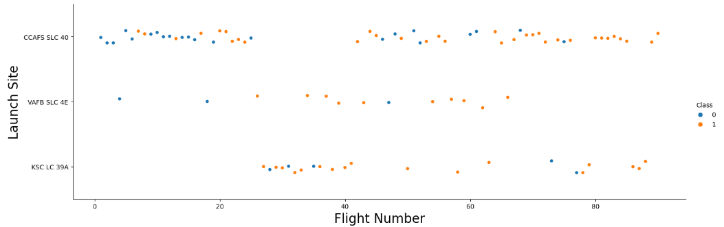
Flight Number vs. Launch Site
A similar patter is observed for the three launch sites: as flight numbers increases, there tends to be more successful landings

Slide 19
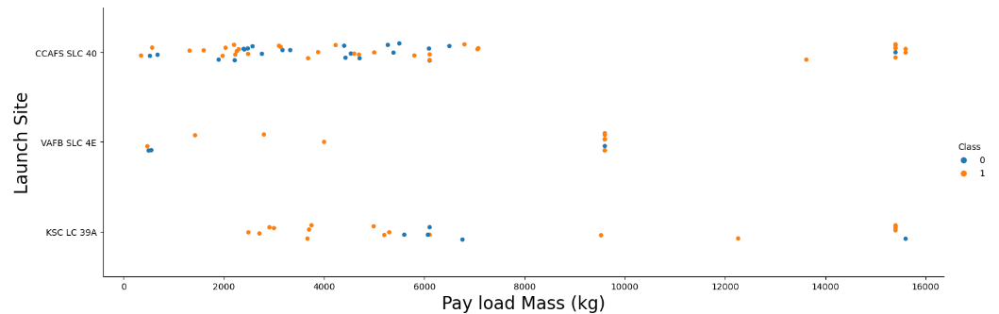
Payload vs. Launch Site
A similar patter is observed for the three launch sites: as payload mass increases, there tends to be more successful landings
The VAFB-SLC launch site does not have launches with payload mass heavier than 10000 kg

Slide 20
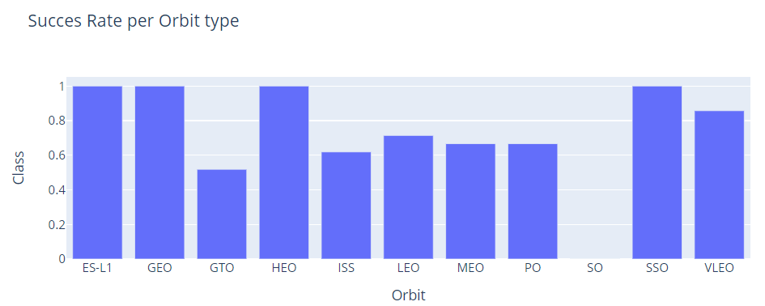
Success Rate vs. Orbit Type
There is no apparent relationship between the altitude of the orbit and landing success
The orbit types with the greatest success rates are ES-L1, GEO, HEO and SSO

Slide 21
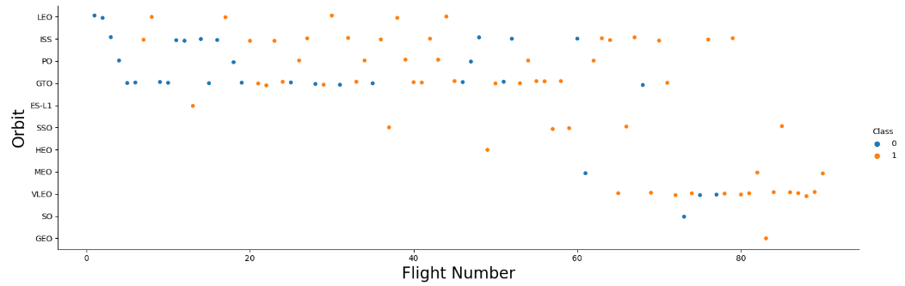
Flight Number vs. Orbit Type
For some orbits like LEO and PO success rate tends to increase with number of flights, but for other orbit types like ISS and GTO no relationship is evident
The orbit types with the greatest success rates ES-L1, GEO, HEO and SSO have only 5 or fewer flights

Slide 22
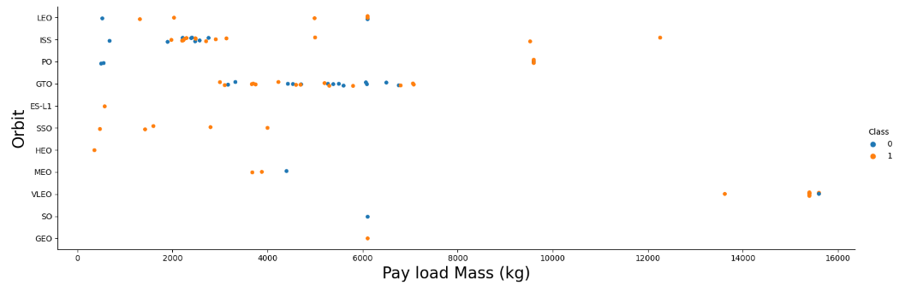
Payload vs. Orbit Type
Success rate for orbit types LEO, ISS and PO increases with payload mass, but for the GTO orbit no relationship is evident
The orbit types with the greatest success rates ES-L1, GEO, HEO and SSO have payload masses of around 6000 kg or less

Slide 23
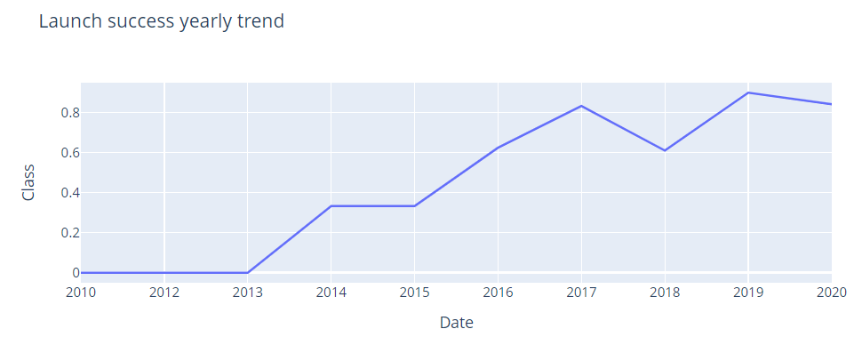
Launch Success Yearly Trend
Since 2013 there has been an overall increase in average success rate per year

Slide 24
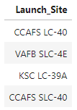
All Launch Site Names
Find the names of the unique launch sites
Falcon 9 rockets are launched by SpaceX from the four following launch sites:

Slide 25
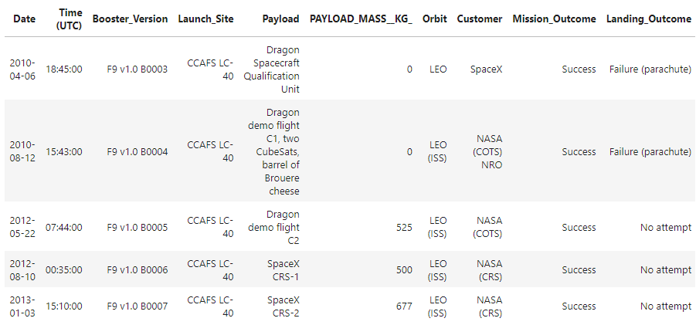
Launch Site Names Begin with 'CCA'
Find 5 records where launch sites begin with `CCA`
The following five records belong to the launch site CCAFS LC-40:

Slide 26
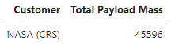
Total Payload Mass
Calculate the total payload carried by boosters from NASA
The total payload mass that has been carried by SpaceX rockets for all launches for their NASA (CRS) customer is over 45000 kg:

Slide 27
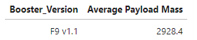
Average Payload Mass by F9 v1.1
Calculate the average payload mass carried by booster version F9 v1.1
The average payload mass that has been carried by the booster version F9 v1.1 is just over 2900 kg:

Slide 28
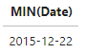
First Successful Ground Landing Date
Find the date of the first successful landing outcome on ground pad
The date when the first successful landing outcome on ground pad was achieved was Dec 22nd, 2015:

Slide 29
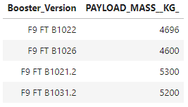
Successful Drone Ship Landing with Payload between 4000 and 6000
List the names of boosters which have successfully landed on drone ship and had payload mass greater than 4000 but less than 6000
The following four booster versions carrying a payload mass larger than 4000 kg but smaller than 6000 kg have successfully landed on drone ships:

Slide 30
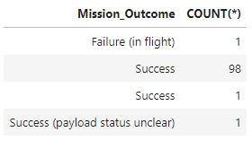
Total Number of Successful and Failure Mission Outcomes
Calculate the total number of successful and failed mission outcomes
The Mission Outcome of SpaceX launches has been largely successful except for one case of a Failure (in flight):

Slide 31
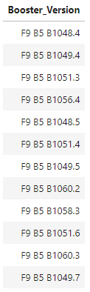
Boosters Carried Maximum Payload
List the names of the booster which have carried the maximum payload mass
The 12 booster versions listed on the right-side table have all carried the maximum payload mass:

Slide 32
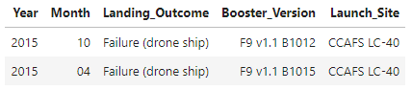
2015 Launch Records
List the records displaying the month, failure landing_outcomes in drone ship, booster version and launch_site for the months of 2015
In April and October 2015 two booster versions launched from the CCAFS LC-40 launch site failed to land in a drone ship:

Slide 33
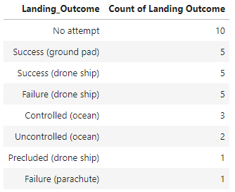
Rank Landing Outcomes Between 2010-06-04 and 2017-03-20
Rank the count of landing outcomes between the date 2010-06-04 and 2017-03-20, in descending order
Between 2010-06-04 and 2017-03-20, there were ten cases where landing was not attempted. There were five cases each of successful landings in ground pads and drone ships, and five cases of failed landings in drone ships.
Other landing outcomes had 3 or fewer cases.

Slide 34

Section 3

Slide 35
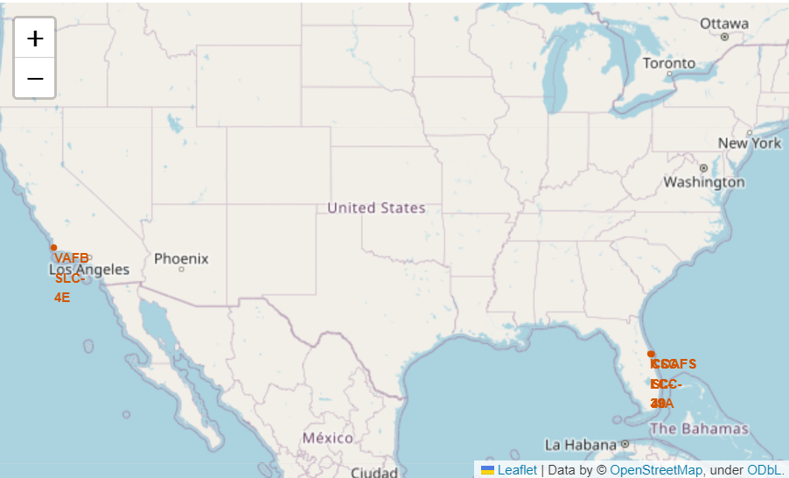
Launch Site Locations
All launch sites are in close proximity to the coast
Launch site VAFB SLC-4E is located in the Pacific coast of the USA
The remaining three launch sites are located in the Atlantic coast of the USA

Slide 36
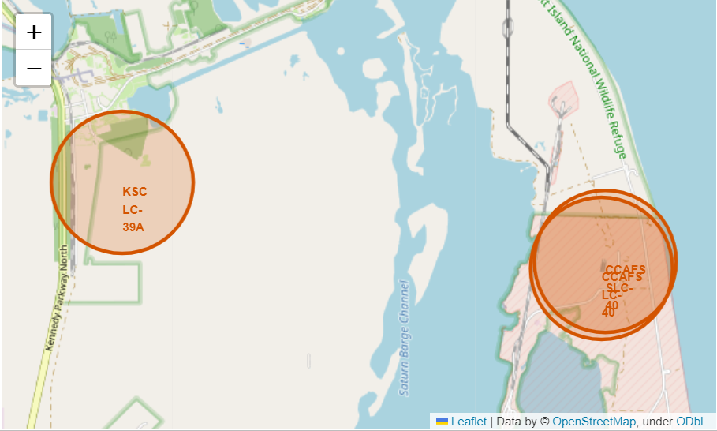
Launch Sites in the Atlantic coast of the USA
Launch sites CCAFS LC-40 and CCAFS SLC-40 are in close proximity of each other

Slide 37
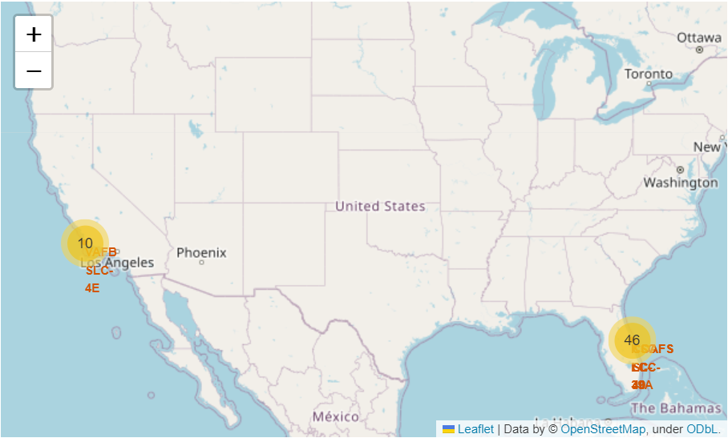
Location and Number of launches
Most launches have taken place at launch sites in the Atlantic coast of the USA
Only 10 launches have been recorded in the Pacific coast launch site

Slide 38
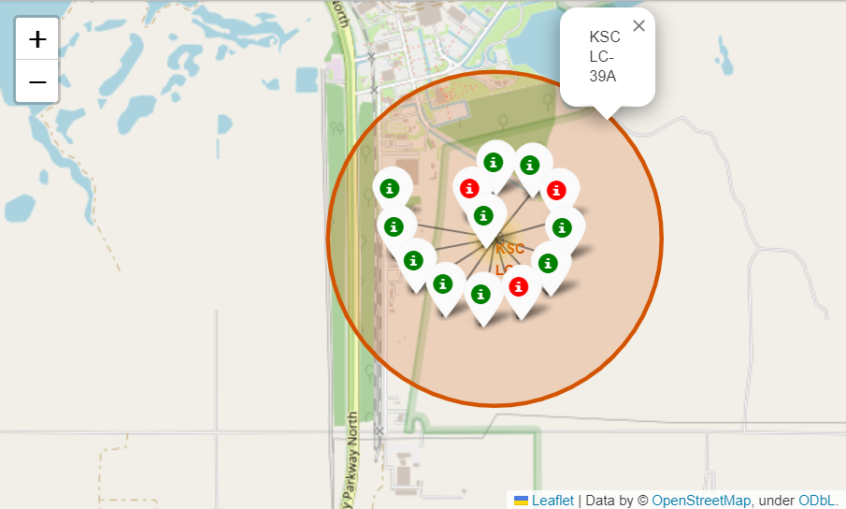
Launch outcomes at site KSC LC-39A
10 out of the 13 launch records at the KSC LC-39A launch site had a successful landing

Slide 39
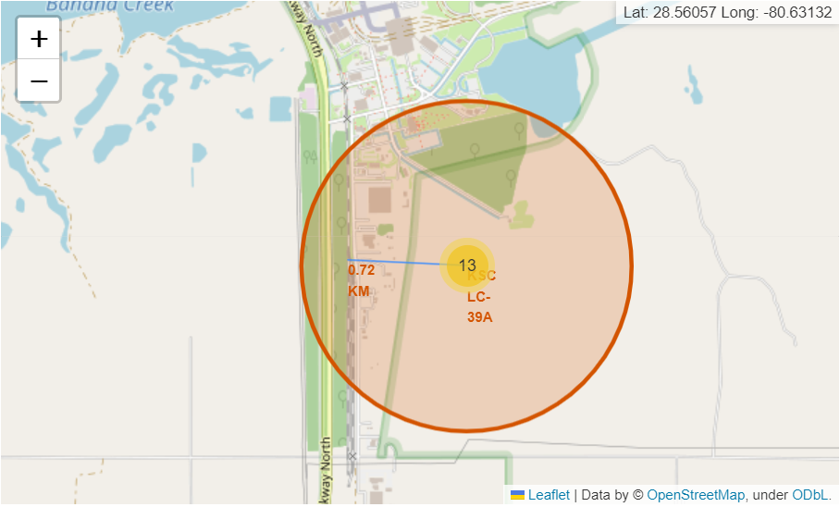
Proximities of launch sites
All launch sites are close to the coast and far away from city centers
The KSC LC-39A launch site is 0.72 km away from the nearest railway

Slide 40

Section 4

Slide 41
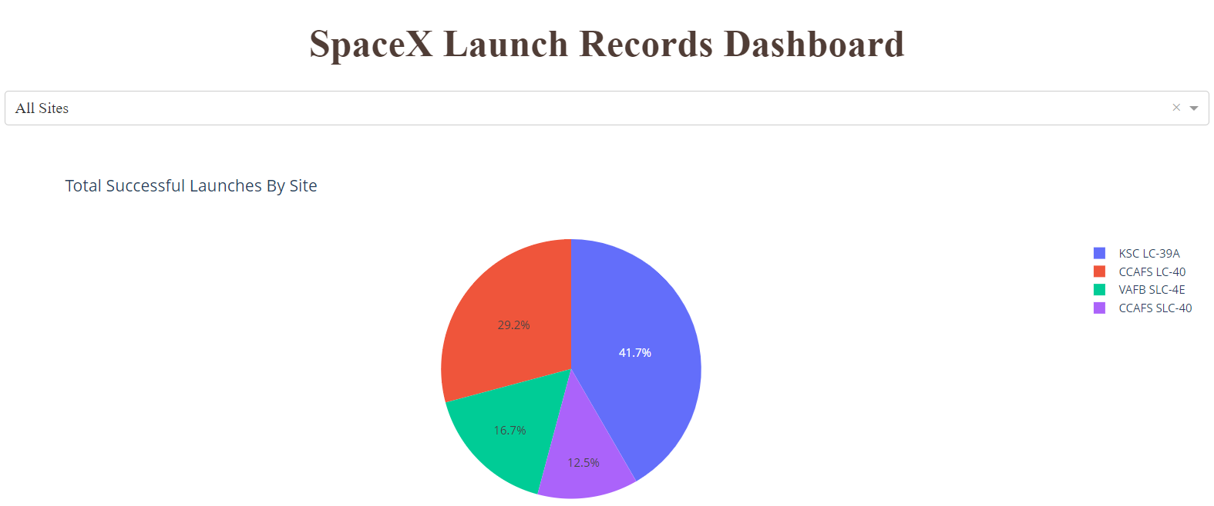
Proportion of Launch Success for All Sites
The launch site with the greatest proportion of successful launches is the KSC LC-39A site with 41.7%, followed by the CCAFS LC-40 site with 29.2%

Slide 42
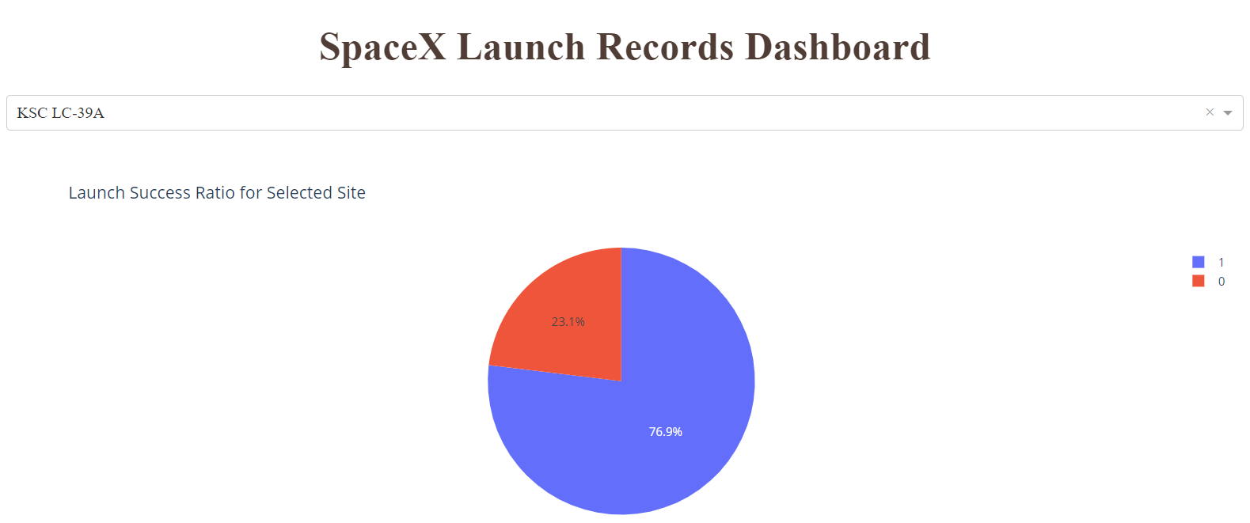
Launch Site with Highest Success Rate
Launch site KSC LC-39A had the highest launch success ratio of 76.9% (10 successful launches out of 13 in total)

Slide 43
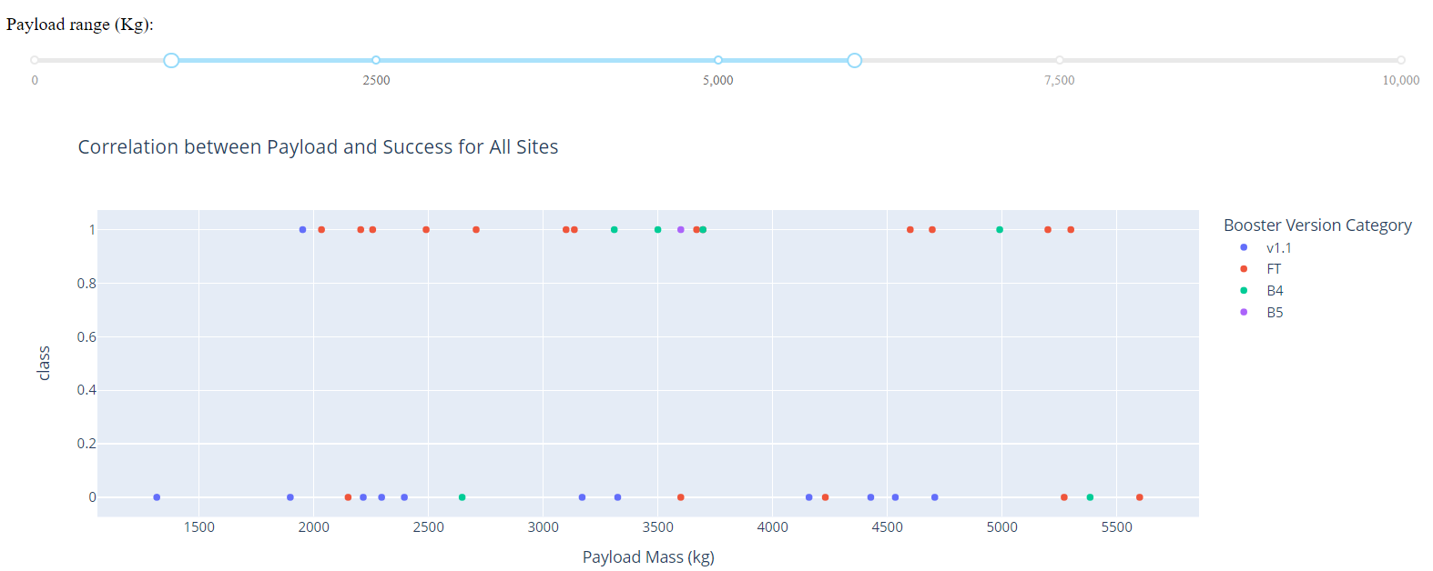
Correlation between payload and launch outcome
Considering all launch sites, the payload mass between approximately 2000 to 5500 kg had the largest success rate

Slide 44
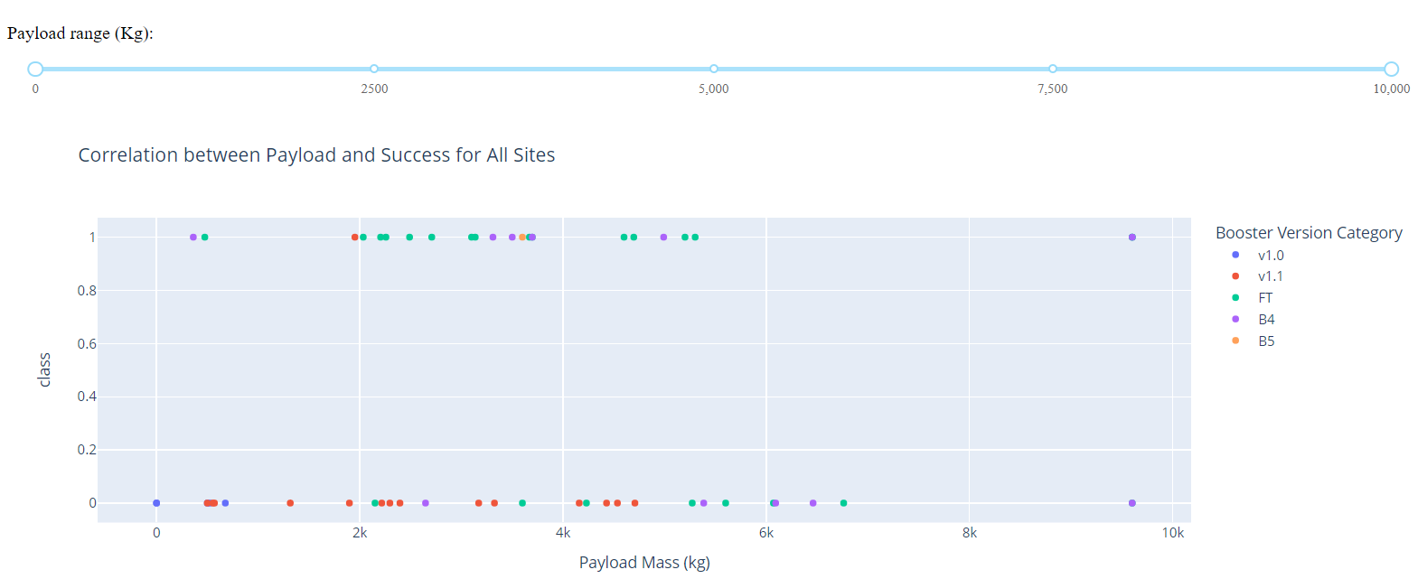
Correlation between payload and launch outcome
Considering all launch sites and all payload masses, booster version FT showed the highest number of successful landings, while booster version v1.1 showed the highest number of failed landings

Slide 45

Section 5

Slide 46
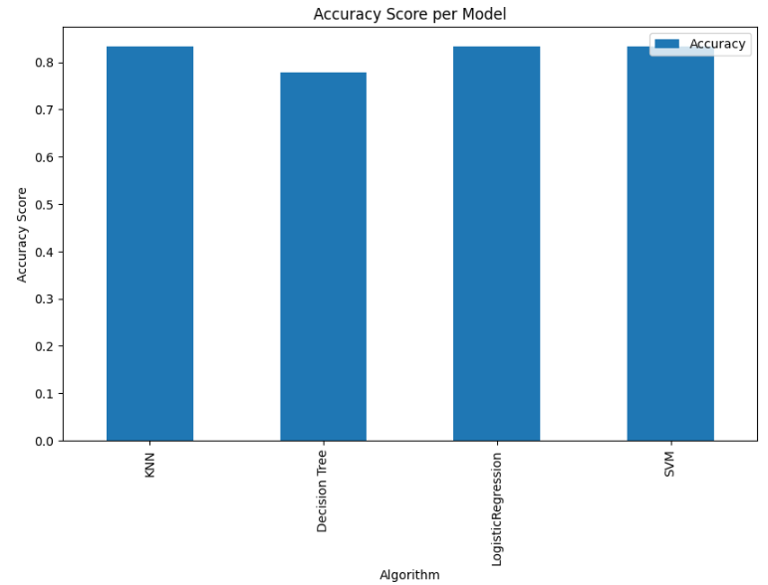
Classification Accuracy
The K Nearest Neighbor, Logistic Regression and Support Vector Machine models resulted in the same accuracy score of 0.8333 on the test data
The Decision Tree model had the lowest performance with an accuracy score of 0.7777 on the test data

Slide 47
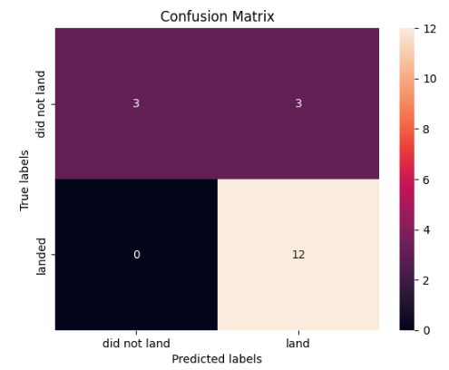
Confusion Matrix
The K Nearest Neighbor, Logistic Regression and Support Vector Machine models showed the same results for the confusion matrix
All successful landings were correctly classified, but three of the failed landings were incorrectly classified as successful

Slide 48
Conclusions
Point 1
Point 2
Point 3
Point 4
…

Slide 49
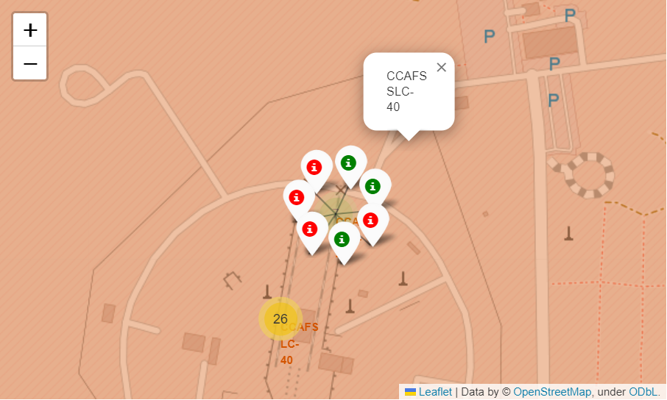
Appendix
Successful and failed launches at the CCAFS SLC-40 site

Slide 50
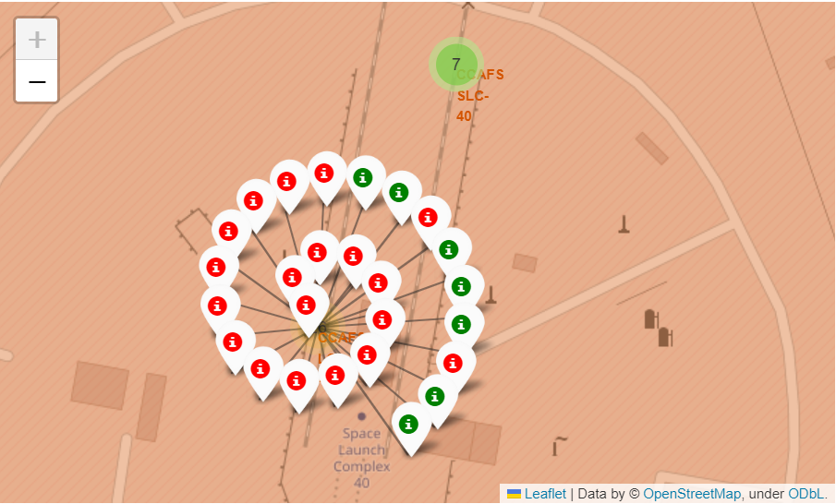
Appendix
Successful and failed launches at the CCAFS LC-40 site

Slide 51
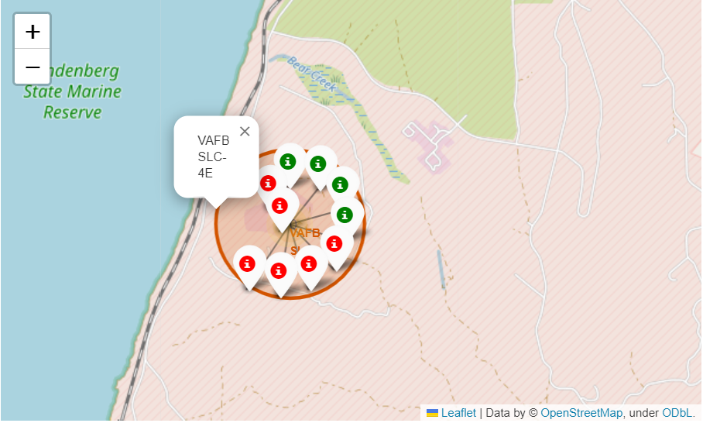
Appendix
Successful and failed launches at the VAFB SLC-4E site

Slide 52
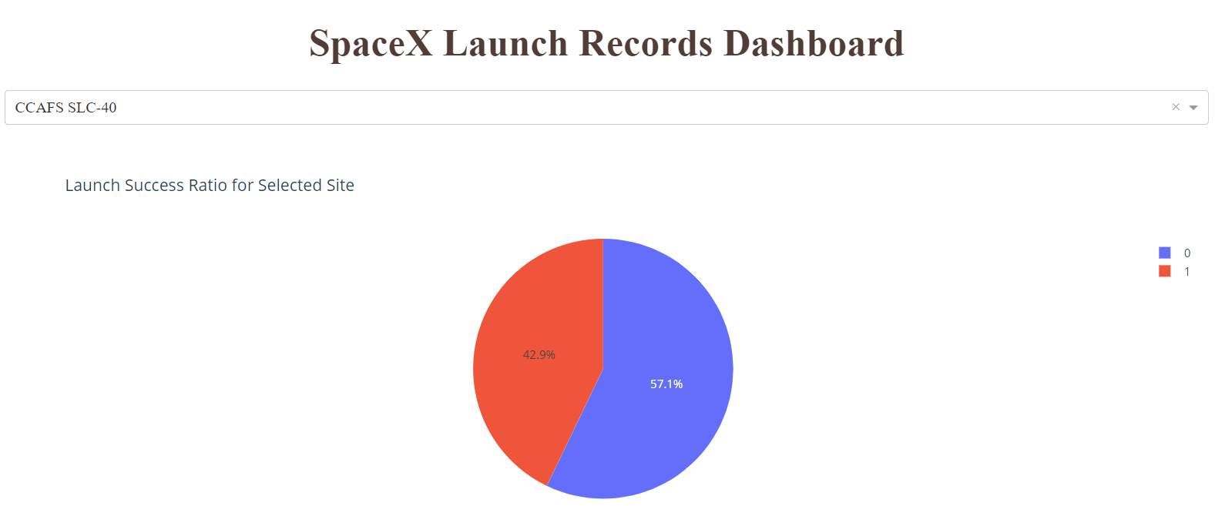
Appendix
The launch success ratio for site CCAFS SLC-40 was 42.9%

Slide 53
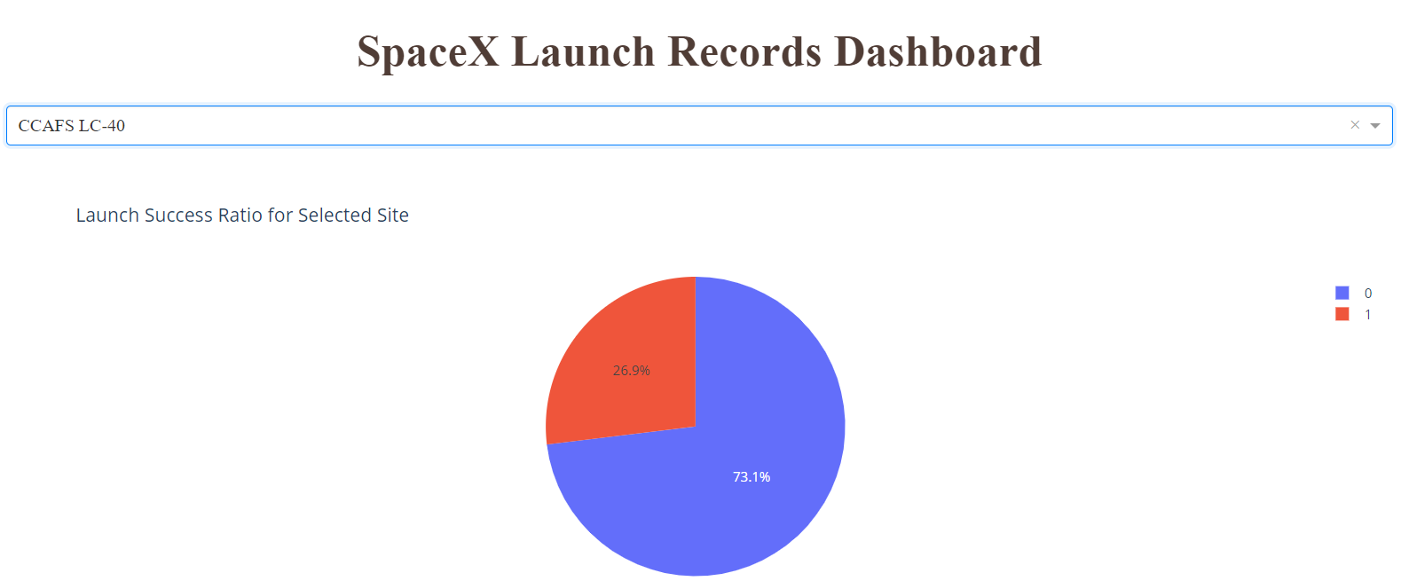
Appendix
The launch success ratio for site CCAFS LC-40 was 26.9%

Slide 54
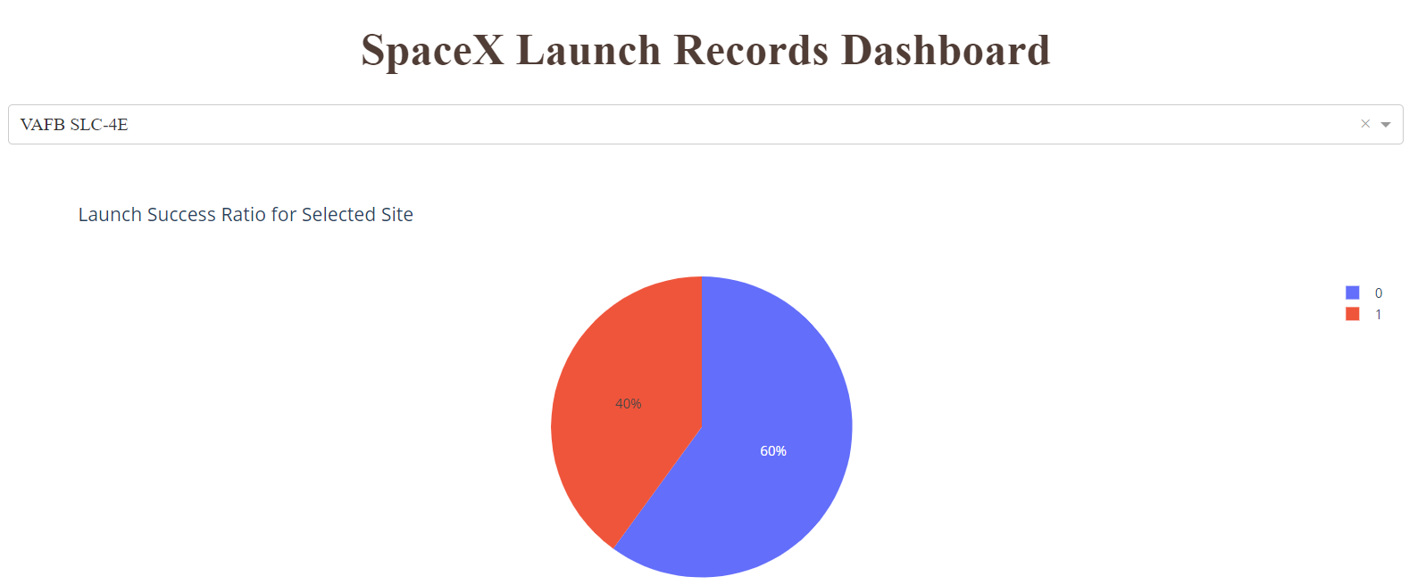
Appendix
The launch success ratio for site VAFB SLC-4E was 40%

Slide 55
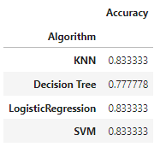
Appendix
The accuracy scores on the test data for the four classification models were the following:

Slide 56


